Slide 1
Streaming data from instruments and the Internet of things
Microsoft Research
Windows Azure for Research Training

Slide 2
Streaming data from instruments and the Internet of things
Learning objectives – what you will learn:
A design pattern for collecting streaming data into the cloud
Examples of when this is useful for research scientists

Slide 3
Agenda
Kafka
Storm
The demo
Notes:
Slide Objectives:
Introduce the topics that will be covered in this session
VALUE PROP
Speaking Points:
Notes:

Slide 4
Apache Kafka
Stream processes in real-time
Developed by LinkedIn
Messages persisted to disk
Messages can be unwound to view histories
Batch importing into HDFS
Operates on batches of messages
High throughput sequential access
Clients can re-consume message streams
Supports publisher-subscriber model
http://kafka.apache.org/
git clone http://git-wip-us.apache.org/repos/asf/kafka.git kafka

Slide 5
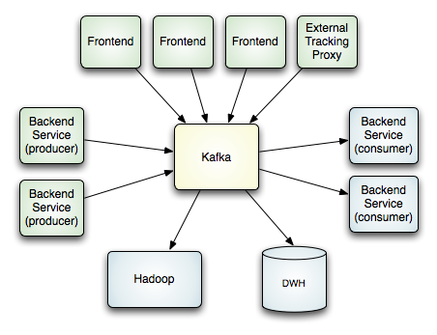
Kafka Architecture

Slide 6
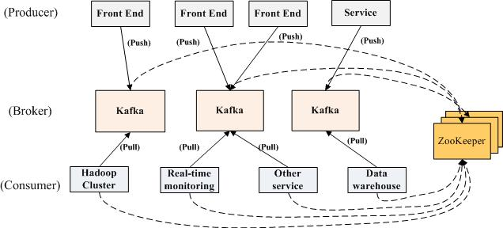
Kafka Architecture

Slide 7

STORM (http://storm-project.net/)
Converts a stream of messages into new streams
Maintained and used by Twitter
Topologies are created to handle stream
Spouts are the stream source, ingest data
Bolts are transformations
Multiple spouts can feed bolts
Bolts can feed other bolts
Clients can re-consume message streams
Supports publisher-subscriber model
Nathan Marz
https://github.com/nathanmarz/storm

Slide 8
STORM Concepts
Streams
Spouts: Source of streams
Bolts: Functions, Filters, Aggregation, Joins, DB R/W
Topologies: Grouping of Spouts and Bolts
Tuples
Tuples
Tuples
Tuples
Tuples
Notes:
The core abstraction in Storm is the "stream". A stream is an unbounded sequence of tuples. Storm provides the primitives for transforming a stream into a new stream in a distributed and reliable way. For example, you may transform a stream of tweets into a stream of trending topics.
A spout is a source of streams. For example, a spout may read tuples off of a Kestrel queue and emit them as a stream. Or a spout may connect to the Twitter API and emit a stream of tweets.
A bolt consumes any number of input streams, does some processing, and possibly emits new streams. Complex stream transformations, like computing a stream of trending topics from a stream of tweets, require multiple steps and thus multiple bolts. Bolts can do anything from run functions, filter tuples, do streaming aggregations, do streaming joins, talk to databases, and more.
Networks of spouts and bolts are packaged into a "topology" which is the top-level abstraction that you submit to Storm clusters for execution. A topology is a graph of stream transformations where each node is a spout or bolt. Edges in the graph indicate which bolts are subscribing to which streams. When a spout or bolt emits a tuple to a stream, it sends the tuple to every bolt that subscribed to that stream.

Slide 9
Topology: Network of Spouts and Bolts
stream
Notes:
A spout is a source of streams. For example, a spout may read tuples off of a Kestrel queue and emit them as a stream. Or a spout may connect to the Twitter API and emit a stream of tweets.
A bolt consumes any number of input streams, does some processing, and possibly emits new streams. Complex stream transformations, like computing a stream of trending topics from a stream of tweets, require multiple steps and thus multiple bolts. Bolts can do anything from run functions, filter tuples, do streaming aggregations, do streaming joins, talk to databases, and more.
Networks of spouts and bolts are packaged into a "topology" which is the top-level abstraction that you submit to Storm clusters for execution. A topology is a graph of stream transformations where each node is a spout or bolt. Edges in the graph indicate which bolts are subscribing to which streams. When a spout or bolt emits a tuple to a stream, it sends the tuple to every bolt that subscribed to that stream.
Storm uses tuples as its data model. A tuple is a named list of values, and a field in a tuple can be an object of any type. Out of the box, Storm supports all the primitive types, strings, and byte arrays as tuple field values. To use an object of another type, you just need to implement a serializer for the type.

Slide 10
Pre-installed for demo
g++
Node.js + NPM
Redis Server
Storm
Kafka client/server
Open JDK
Maven
Leiningen

Slide 11
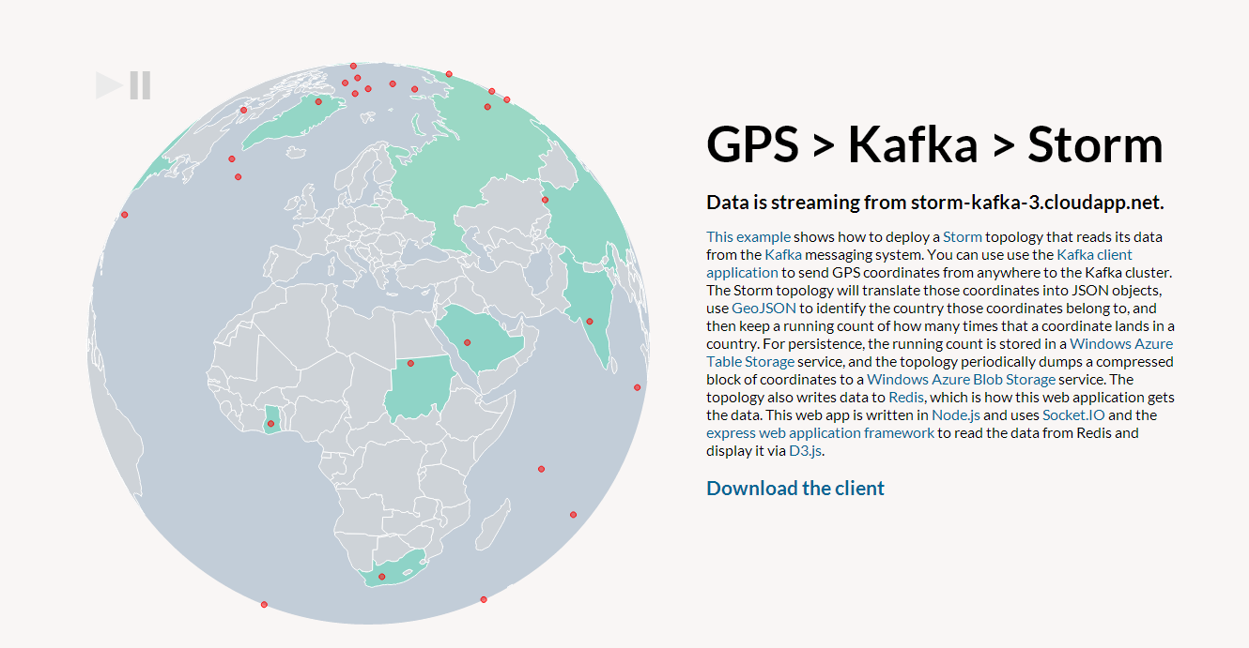

Slide 12
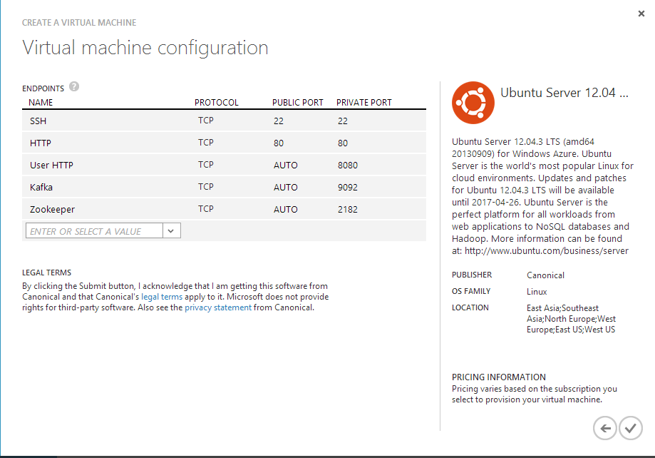
Endpoint Configuration

Slide 13
A GPS Demo with Storm
Demo
Notes:
1 – simple Example
2 – Real world – KINECT!

Slide 14
Useful links
Kafka spout: https://github.com/nathanmarz/storm-contrib/tree/master/storm-kafka
Storm: https://github.com/amplab/shark/wiki
Apache Kafka: http://mesos.apache.org/
Notes:
Slide Objective
Understand a Windows Azure storage account
VALUE PROP
Speaking notes
The Windows Azure Content Delivery Network (CDN) offers developers a global solution for delivering high-bandwidth content by caching blobs and static content of compute instances at physical nodes in the United States, Europe, Asia, Australia and South America.
A Windows Azure subscription contains storage accounts
Can explicitly geo-locate to a sub region or set affinity with other services
Can enable CDN at the account level (means that public containers will be retrievable via the CDN URL)
100 TBs per account means a lot of storage for very little cost
Notes
You should change the access keys to your storage account periodically to help keep your storage connections more secure. Two access keys are assigned to enable you to maintain connections to the storage account using one access key while you regenerate the other access key.

Slide 15
Streaming data from instruments and the Internet of things
Learning objectives – what we have learned:
A design pattern for collecting streaming data into the cloud
Examples of when this is useful for research scientists

Slide 16
© 2013 Microsoft Corporation. All rights reserved. Microsoft, Windows, Windows Vista and other product names are or may be registered trademarks and/or trademarks in the U.S. and/or other countries.
The information herein is for informational purposes only and represents the current view of Microsoft Corporation as of the date of this presentation. Because Microsoft must respond to changing market conditions, it should not be interpreted to be a commitment on the part of Microsoft, and Microsoft cannot guarantee the accuracy of any information provided after the date of this presentation. MICROSOFT MAKES NO WARRANTIES, EXPRESS, IMPLIED OR STATUTORY, AS TO THE INFORMATION IN THIS PRESENTATION.

